Slide 1
MNIST Handwritten Digit Recognition
GROUP MEMBERS :
Sravani Kalangi : 201501104
Roshani : 201601059
Samhitha Gundam: 201601065

Slide 2
Introduction
MNIST database (Modified National Institute of Standards and Technology database)is a large database of handwritten digits that is commonly used for training and image processing system.
The MNIST database contains 60,000 training images and 10,000 testing images. Half of the training set and half of the test set were taken from NIST's training dataset, while the other half of the training set and the other half of the test set were taken from NIST's testing dataset

Slide 3
Convolutional Neural Network
A CNN is an artificial neural network that is used for image and analysis and various other purposes because of its pattern recognition property. A CNN consists of various convolutional layers. Each convolution layer has certain filters that help us determine the pattern. For eg : one type of filter for image analysis can be to determine edges. This filter would be known as edge detector. Similarly some filters will detect corners, circles, squares, birds etc. The deeper the network goes more sophisticated the filters get.

Slide 4
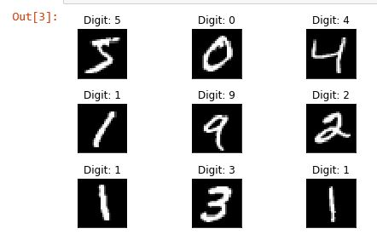

Slide 5
Implementation
Let us consider a dataset consisting of handwritten digits. The first hidden layer in our model is a convolutional layer. When a convolutional is added the filters that we require must be specified. A filter can be thought of as a relatively small matrix whose number of rows and columns are specified by us. Suppose we take a 3x3 matrix for a filter, then the filter will slide over every 3x3 pixels of the image and this is known as convolving the image. This image will then be passed to the convolution layer and then pass through other filters. Each time the image is convolved the data is stored and passed on to the layers.

Slide 6
Sequential Model
Convolutional layer with ‘RELU’ activation function and using 32 3x3 filters.
Convolutional layer with ‘RELU’ activation function and using 64 3x3 filters.
Max pooling with pool size 2x2.
Dropout with 25% of the data.
Flatten
Fully connected layer with activation function ‘RELU’ and 128 neurons.
Dropout with 50% of the data.
Final layer (fully connected) with 10 neurons with softmax functions which gives the final probability.

Slide 7
Training Model
In our project we have written a code using the tensorflow library in python and trained the model.
The black and white images from NIST were size-normalized and centered to fit into a 28x28 pixel bounding box and anti-aliased, which introduced grayscale levels.
Accuracy :- 98.69

Slide 8
Final Output
We import the sequential model into a json file and then further used it for prediction of the handwritten digit input by the user. And for taking in the user input we have made a simple web interface using flask,html and css.

Slide 9
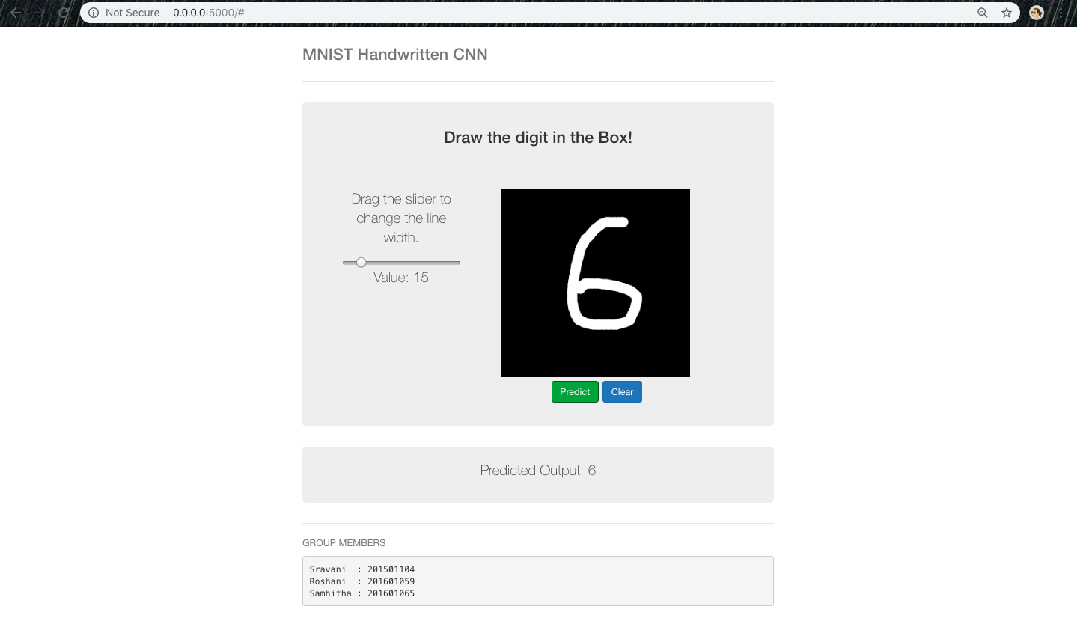

Slide 10
THANK YOU!!!

